Slide 1


Slide 2

Direct benefits of a data warehouse
  Allows end users to perform extensive analysis
  Allows a consolidated view of corporate data
  Better and more timely information A
  Enhanced system performance
  Simplification of data access

Slide 3
Indirect benefits result from end users using these direct benefits
  Enhance business knowledge
  Present competitive advantage
  Enhance customer service and satisfaction
  Facilitate decision making
  Help in reforming business processes

Slide 4
Data warehouse vendors
  Six guidelines to considered when developing a vendor list:
    Financial strength
    ERP linkages
    Qualified consultants
    Market share
    Industry experience
    Established partnerships

Slide 5
Data warehouse development approaches
  Inmon Model: EDW approach
  Kimball Model: Data mart approach
Which model is best?
  There is no one-size-fits-all strategy to data warehousing
  One alternative is the hosted warehouse

Slide 6
Data warehouse structure: The Star Schema
  Dimensional modeling
  A retrieval-based system that supports high-volume query access
  Dimension tables
  A table that address how data will be analyzed

Slide 7

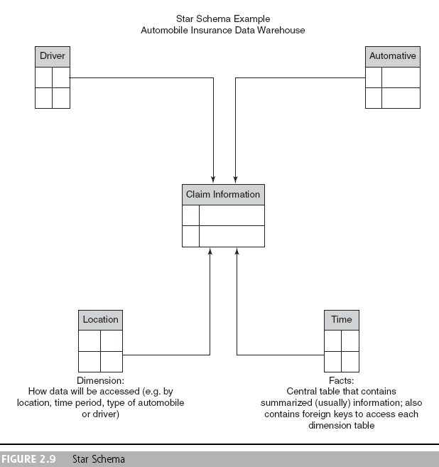

Slide 8
Grain
A definition of the highest level of detail that is supported in a data warehouse
Drill-down
The process of probing beyond a summarized value to investigate each of the detail transactions that comprise the summary

Slide 9
Data warehousing implementation issues
  Implementing a data warehouse is generally a massive effort that must be planned and executed according to established methods
  There are many facets to the project lifecycle, and no single person can be an expert in each area

Slide 10

Eleven major tasks that could be performed in parallel for successful implementation of a data warehouse (Solomon, 2005) :
Establishment of service-level agreements and data-refresh requirements
Identification of data sources and their governance policies
Data quality planning
Data model design
ETL tool selection

Slide 11
Relational database software and platform selection
Data transport
Data conversion
Reconciliation process
Purge and archive planning
End-user support

Slide 12
Some best practices for implementing a data warehouse (Weir, 2002):
  Project must fit with corporate strategy and business objectives
  There must be complete buy-in to the project by executives, managers, and users
  It is important to manage user expectations about the completed project
  The data warehouse must be built incrementally
  Build in adaptability

Slide 13
Some best practices for implementing a data warehouse (Weir, 2002):
  The project must be managed by both IT and business professionals
  Develop a business/supplier relationship
  Only load data that have been cleansed and are of a quality understood by the organization
  Do not overlook training requirements
  Be politically aware

Slide 14
Failure factors in data warehouse projects:
  Cultural issues being ignored
  Inappropriate architecture
  Unclear business objectives
  Missing information
  Unrealistic expectations
  Low levels of data summarization
  Low data quality

Slide 15
Issues to consider to build a successful data warehouse:
  Starting with the wrong sponsorship chain
  Setting expectations that you cannot meet and frustrating executives at the moment of truth
  Engaging in politically naive behavior
  Loading the warehouse with information just because it is available

Slide 16
Issues to consider to build a successful data warehouse:
  Believing that data warehousing database design is the same as transactional database design
  Choosing a data warehouse manager who is technology oriented rather than user oriented
  Focusing on traditional internal record-oriented data and ignoring the value of external data and of text, images, and, perhaps, sound and video

Slide 17
Issues to consider to build a successful data warehouse:
  Delivering data with overlapping and confusing definitions
  Believing promises of performance, capacity, and scalability
  Believing that your problems are over when the data warehouse is up and running
  Focusing on ad hoc data mining and periodic reporting instead of alerts

Slide 18
Implementation factors that can be categorized into three criteria
  Organizational issues
  Project issues
  Technical issues
User participation in the development of data and access modeling is a critical success factor in data warehouse development

Slide 19
Massive data warehouses and scalability
  The main issues pertaining to scalability:
    The amount of data in the warehouse
    How quickly the warehouse is expected to grow
    The number of concurrent users
    The complexity of user queries
  Good scalability means that queries and other data-access functions will grow linearly with the size of the warehouse

Slide 20

Real-time (active) data warehousing
The process of loading and providing data via a data warehouse as they become available

Slide 21
Levels of data warehouses:
  Reports what happened
  Some analysis occurs
  Provides prediction capabilities,
  Operationalization
  Becomes capable of making events happen

Slide 22

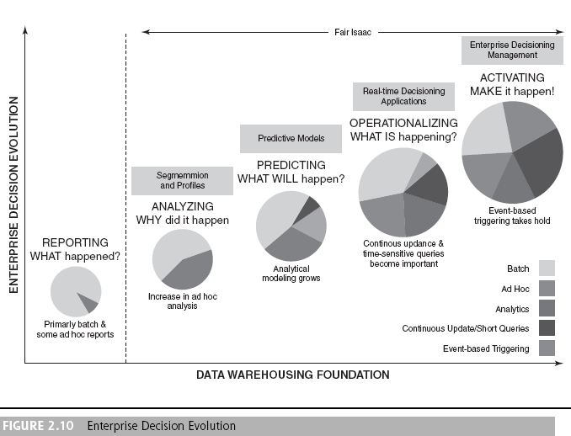

Slide 23
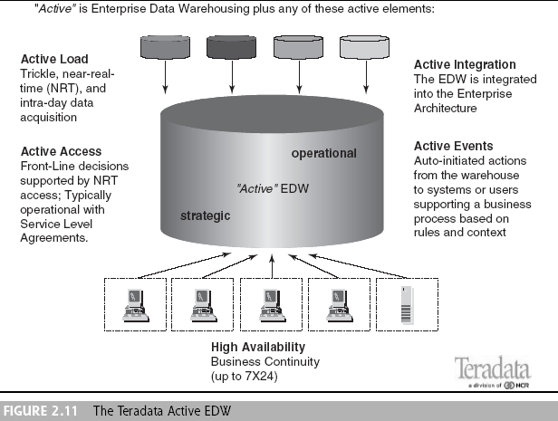

Slide 24
The need for real-time data
  A business often cannot afford to wait a whole day for its operational data to load into the data warehouse for analysis
  Provides incremental real-time data showing every state change and almost analogous patterns over time
  Maintaining metadata in sync is possible
  Less costly to develop, maintain, and secure one huge data warehouse so that data are centralized for BI/BA tools
  An EAI with real-time data collection can reduce or eliminate the nightly batch processes

Slide 25

Data warehouse administrator (DWA)
A person responsible for the administration and management of a data warehouse

Slide 26
Effective security in a data warehouse should focus on four main areas:
  Establishing effective corporate and security policies and procedures
  Implementing logical security procedures and techniques to restrict access
  Limiting physical access to the data center environment
  Establishing an effective internal control review process with an emphasis on security and privacy

